Slide 1
The sorting methods of algorithm
The presentation of TEAM-1

Slide 2
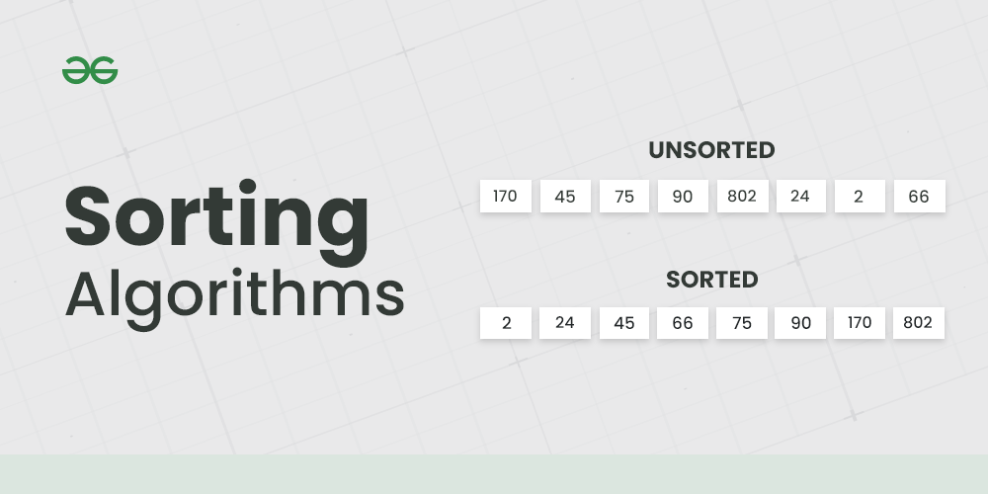
The sorting algorithms
Today, we would like to give some information about sorting methods, and our presentation is based on this topic. Now let’s show our presentation

Slide 3
The main contents of slide
Bubble sort
Quick sort
01
02
Heap sort
Insertion sort
03
04

Slide 4
What is the sorting methods algorithm
So, we would like to give some information about sorts.
A sorting algorithm is a method for reorganizing a large number of items into a specific order, such as alphabetical, highest-to-lowest value, or shortest-to-longest distance. Sorting algorithms take lists of items as input data, perform specific operations on those lists, and deliver ordered arrays as output. The many applications of sorting algorithms include organizing items by price on a retail website and determining the order of sites on a search engine results page.
And there are some types of sorting algorithms
For instance, the bubble sort, the insertion sort, the shell sort, the quick sort, the heap sort, the selection sort

Slide 5
Bubble Sort
01

Slide 6
The main ideas
The bubble sort algorithm repeatedly proceeds through the list, comparing pairs of adjacent items and exchanging their positions if they are in the wrong order. The algorithm passes through the list in that way until the entire list has been sorted
Bubble Sort is the simplest sorting algorithm that works by repeatedly swapping the adjacent elements if they are in the wrong order. This algorithm is not suitable for large data sets as its average and worst-case time complexity is quite high.

Slide 8
Bubble Sort Algorithm
In this algorithm,
traverse from left and compare adjacent elements and the higher one is placed at right side.
In this way, the largest element is moved to the rightmost end at first.
This process is then continued to find the second largest and place it and so on until the data is sorted.

Slide 9
Working of Bubble Sort
Suppose we are trying to sort the elements in ascending order.
1. First Iteration (Compare and Swap)
Starting from the first index, compare the first and the second elements.
If the first element is greater than the second element, they are swapped.
Now, compare the second and the third elements. Swap them if they are not in order.
The above process goes on until the last element.

Slide 10
The time complexity in bubble sort is shown like that: 1. Time Complexities
Worst Case Complexity: O(n²) If we want to sort in ascending order and the array is in descending order then the worst case occurs.
Best Case Complexity: O(n) If the array is already sorted, then there is no need for sorting.
Average Case Complexity: O(n²) It occurs when the elements of the array are in jumbled order (neither ascending nor descending).

Slide 11
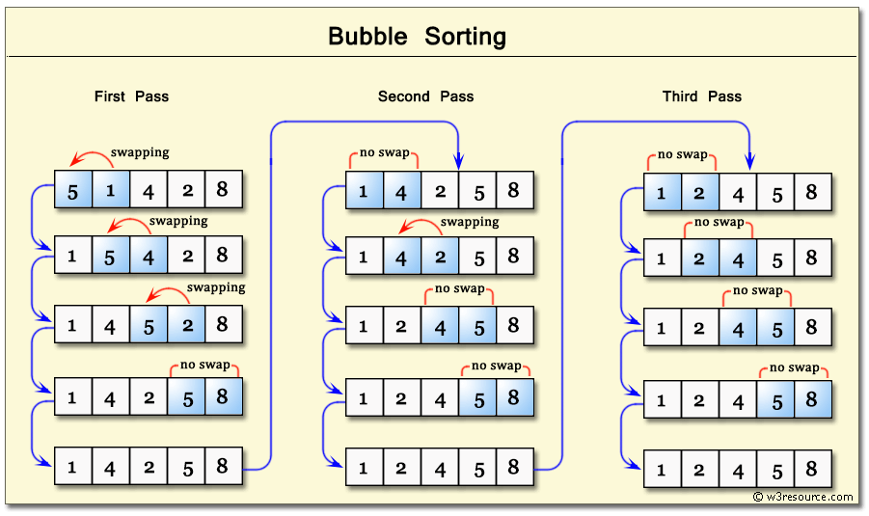
Advantages of Bubble Sort:
Bubble sort is easy to understand and implement.
It does not require any additional memory space.
It is a stable sorting algorithm, meaning that elements with the same key value maintain their relative order in the sorted output.
Disadvantages of Bubble Sort:
Bubble sort has a time complexity of O(N2) which makes it very slow for large data sets.
Bubble sort is a comparison-based sorting algorithm, which means that it requires a comparison operator to determine the relative order of elements in the input data set. It can limit the efficiency of the algorithm in certain cases.

Slide 12
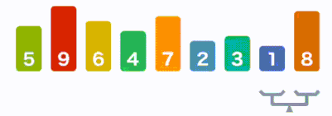
Where is the Bubble sort algorithm used?
Due to its simplicity, bubble sort is often used to introduce the concept of a sorting algorithm. In computer graphics, it is popular for its capability to detect a tiny error (like a swap of just two elements) in almost-sorted arrays and fix it with just linear complexity (2n).

Slide 13

The explanation of sorting

Slide 14
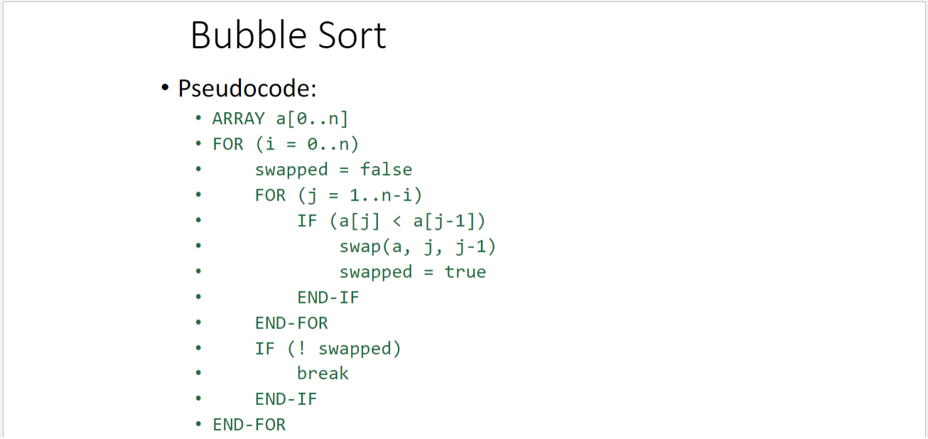
There are pseudocodes of each sorting method. Due to this, bubble sort contains pseudocode. Lets show that.

Slide 15
Insertion sort
02

Slide 16

Insertion sort is a simple and intuitive sorting algorithm in which we build the sorted array using one element at a time. It is easy to implement and is quite efficient for small sets of data, especially for substantially sorted data. It is flexible — it is useful in scenarios where all the array elements are not available in the beginning.

Slide 17
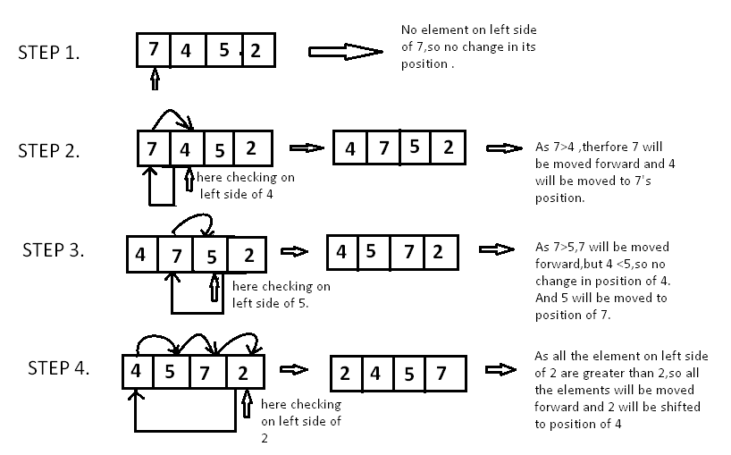

Slide 18
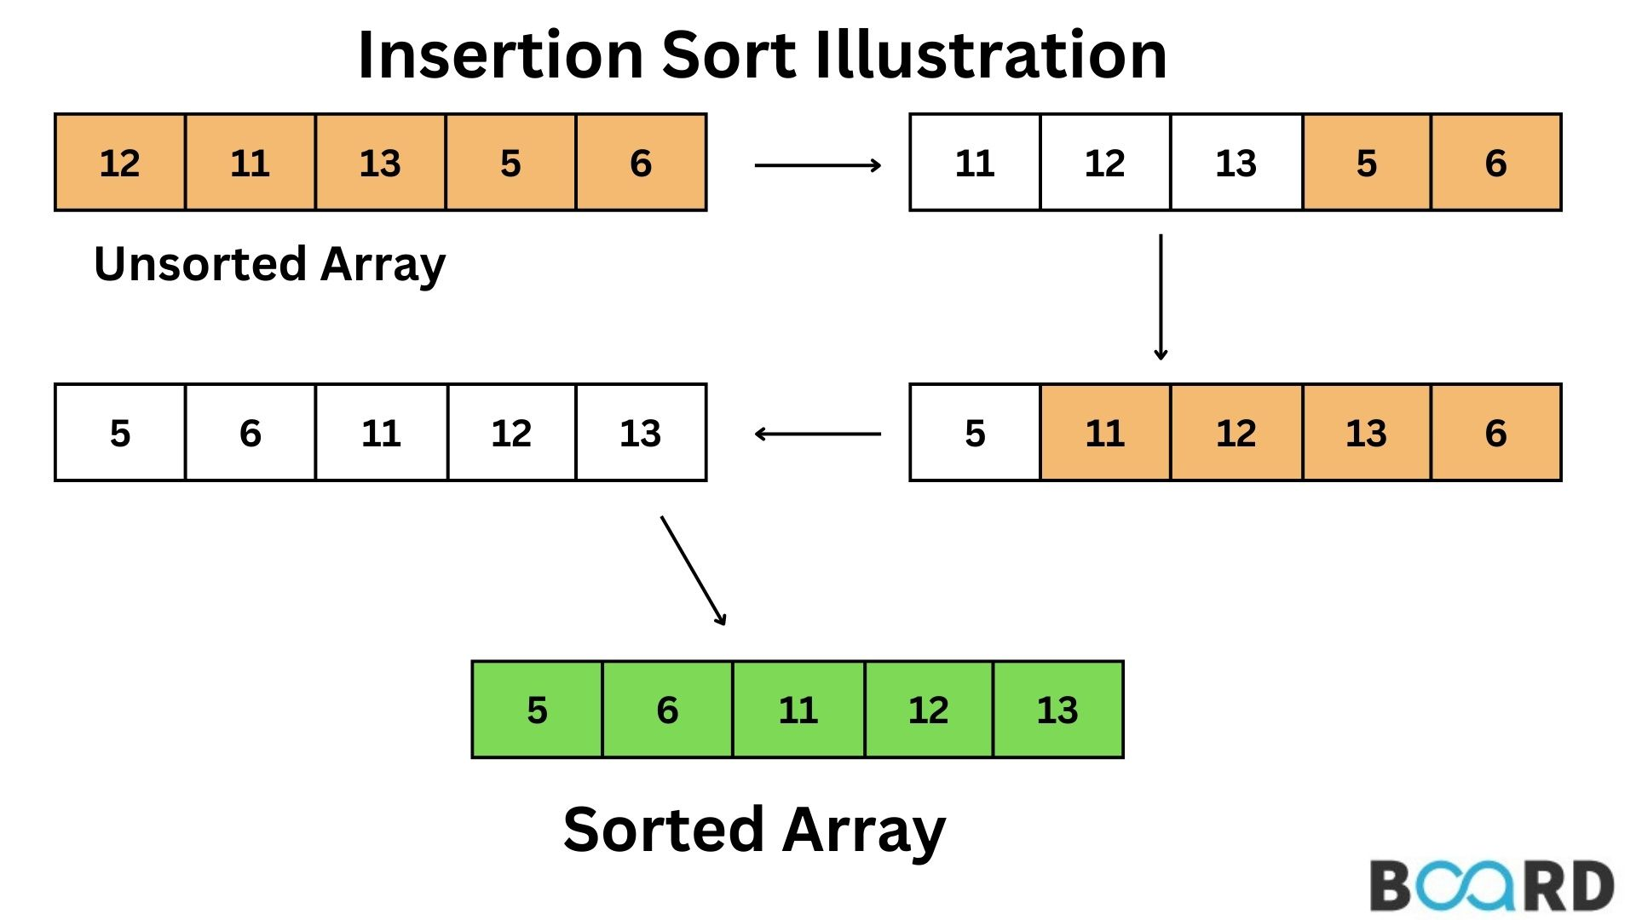
You may have used this sorting method unknowingly at some point in your life. Insertion sort is also known as “card player” sort. If you’ve ever played a game of cards, chances are you have used some form of insertion sort to arrange the cards in your hand in a strategic order.

Slide 19
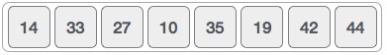
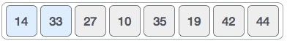
How insertion sort works
We Take an unsorted array for our example.
Insertion sort compares the first two elements.

Slide 20
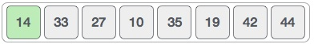
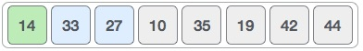
It finds that both 14 and 33 are already in ascending order. For now, 14 is in sorted sub-list.
Insertion sort moves ahead and compares 33 with 27.

Slide 21
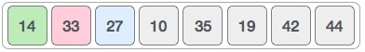
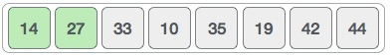
And finds that 33 is not in the correct position.
It swaps 33 with 27. It also checks with all the elements of sorted sub-list. Here we see that the sorted sub-list has only one element 14, and 27 is greater than 14. Hence, the sorted sub-list remains sorted after swapping.

Slide 22
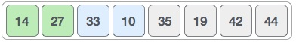
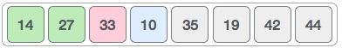
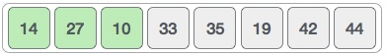
By now we have 14 and 27 in the sorted sub-list. Next, it compares 33 with 10.
These values are not in a sorted order.
So we swap them.

Slide 23
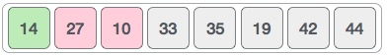
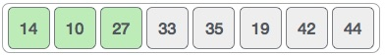
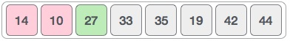
However, swapping makes 27 and 10 unsorted.
Hence, we swap them too.
Again we find 14 and 10 in an unsorted order.

Slide 24

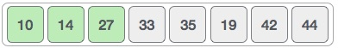
We swap them again. By the end of third iteration, we have a sorted sub-list of 4 items.
Characteristics of Insertion Sort
This algorithm is one of the simplest algorithms with a simple implementation
Basically, Insertion sort is efficient for small data values
Insertion sort is adaptive in nature, i.e. it is appropriate for data sets that are already partially sorted.

Slide 25
Complexity Analysis of Insertion Sort:
Time Complexity of Insertion Sort
The worst-case time complexity of the Insertion sort is O(N^2)
The average case time complexity of the Insertion sort is O(N^2)
The time complexity of the best case is O(N).
Space Complexity of Insertion Sort
The auxiliary space complexity of Insertion Sort is O(1)

Slide 26
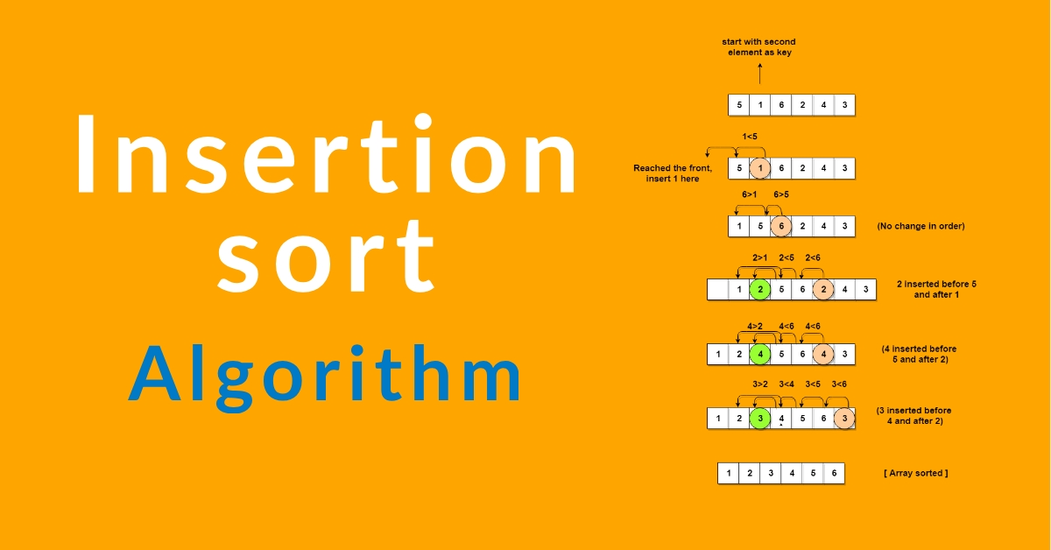
PSEUDO CODE
Initialize n = Length of Array
InsertionSort(Array, n){
for i = 1 to n - 1 {
value = Array[i]
position = i
while (position > 0 and Array[position - 1] > value)
{ Array[position] = Array[position - 1]
position = position - 1 }
Array[position] = value } }

Slide 27
Code of Insertion Sort

Slide 28
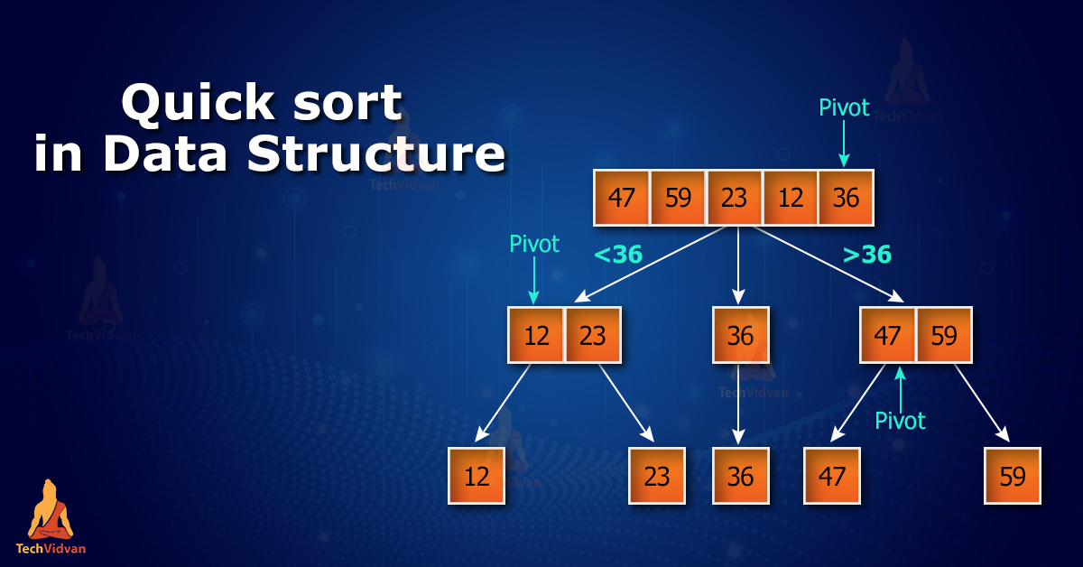
03
Quick Sort

Slide 29
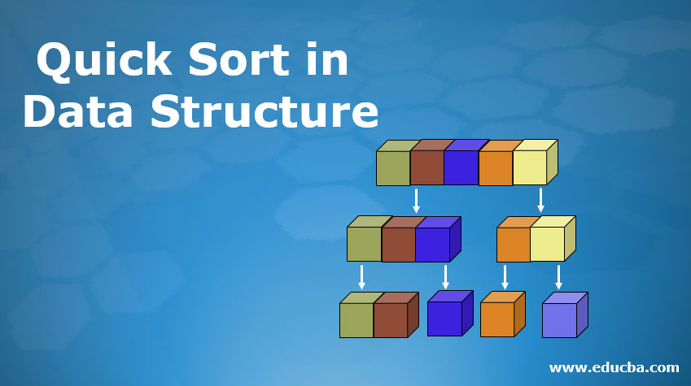
What is the quick sort? What is the purpose of that
QuickSort is a sorting algorithm based on the Divide and Conquer algorithm that picks an element as a pivot and partitions the given array around the picked pivot by placing the pivot in its correct position in the sorted array

Slide 30
How does QuickSort work?
The key process in quickSort is a partition(). The target of partitions is to place the pivot (any element can be chosen to be a pivot) at its correct position in the sorted array and put all smaller elements to the left of the pivot, and all greater elements to the right of the pivot.
Partition is done recursively on each side of the pivot after the pivot is placed in its correct position and this finally sorts the array.

Slide 31
Choice of Pivot:
There are many different choices for picking pivots.
Always pick the first element as a pivot.
Always pick the last element as a pivot (implemented below)
Pick a random element as a pivot.
Pick the middle as the pivot.

Slide 32
Partition Algorithm
The logic is simple, we start from the leftmost element and keep track of the index of smaller (or equal) elements as i. While traversing, if we find a smaller element, we swap the current element with arr[i]. Otherwise, we ignore the current element.
Let us understand the working of partition and the Quick Sort algorithm with the help of the following example:
Consider: arr[] = {10, 80, 30, 90, 40}.

Slide 33
Compare 10 with the pivot and as it is less than pivot arrange it accrodingly.
Compare 80 with the pivot. It is greater than pivot

Slide 34
Compare 30 with pivot. It is less than pivot so arrange it accordingly
Compare 90 with the pivot. It is greater than the pivot.

Slide 35

Arrange the pivot in its correct position.

Slide 36
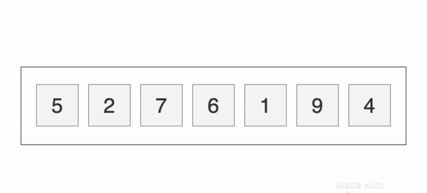
Illustration of Quicksort:
As the partition process is done recursively, it keeps on putting the pivot in its actual position in the sorted array. Repeatedly putting pivots in their actual position makes the array sorted.

Slide 37
Complexity Analysis of Quick Sort:
Time Complexity:
Best Case: Ω (N log (N)) The best-case scenario for quicksort occur when the pivot chosen at the each step divides the array into roughly equal halves. In this case, the algorithm will make balanced partitions, leading to efficient Sorting.
Average Case: θ ( N log (N)) Quicksort’s average-case performance is usually very good in practice, making it one of the fastest sorting Algorithm.
Worst Case: O(N2) The worst-case Scenario for Quicksort occur when the pivot at each step consistently results in highly unbalanced partitions. When the array is already sorted and the pivot is always chosen as the smallest or largest element.

Slide 38
Advantages of Quick Sort:
It is a divide-and-conquer algorithm that makes it easier to solve problems.
It is efficient on large data sets.
It has a low overhead, as it only requires a small amount of memory to function.
Disadvantages of Quick Sort:
It has a worst-case time complexity of O(N²), which occurs when the pivot is chosen poorly.
It is not a good choice for small data sets.

Slide 39
Code of quick Sort

Slide 40
Heap Sort
04

Slide 41
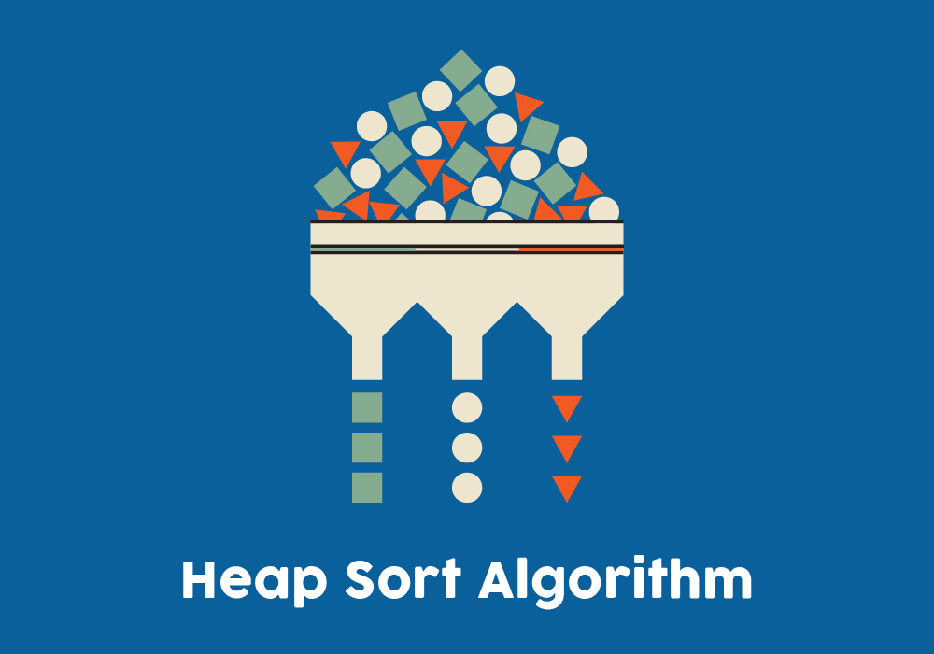
What is the Heap Sort?
Heap sort is a comparison-based sorting technique based on Binary Heap data structure. It is similar to the selection sort where we first find the minimum element and place the minimum element at the beginning. Repeat the same process for the remaining elements.

Slide 42
Heap Sort Algorithm
To solve the problem follow the below idea:
First convert the array into heap data structure using heapify, then one by one delete the root node of the Max-heap and replace it with the last node in the heap and then heapify the root of the heap. Repeat this process until size of heap is greater than 1.
Build a heap from the given input array.
Repeat the following steps until the heap contains only one element:
Swap the root element of the heap (which is the largest element) with the last element of the heap.
Remove the last element of the heap (which is now in the correct position).
Heapify the remaining elements of the heap.
The sorted array is obtained by reversing the order of the elements in the input array.

Slide 43
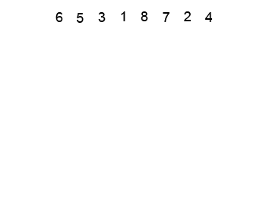
Detailed Working of Heap Sort
To understand heap sort more clearly, let’s take an unsorted array and try to sort it using heap sort. Consider the array: arr[] = {4, 10, 3, 5, 1}.

Slide 44
Transform into max heap: After that, the task is to construct a tree from that unsorted array and try to convert it into max heap.
To transform a heap into a max-heap, the parent node should always be greater than or equal to the child nodes
Here, in this example, as the parent node 4 is smaller than the child node 10, thus, swap them to build a max-heap.
Now, 4 as a parent is smaller than the child 5, thus swap both of these again and the resulted heap and array should be like this:

Slide 45
Perform heap sort: Remove the maximum element in each step (i.e., move it to the end position and remove that) and then consider the remaining elements and transform it into a max heap.
Delete the root element (10) from the max heap. In order to delete this node, try to swap it with the last node, i.e. (1). After removing the root element, again heapify it to convert it into max heap.
Resulted heap and array should look like this:

Slide 46
Repeat the above steps and it will look like the following:
Now remove the root (i.e. 3) again and perform heapify.

Slide 47
Now when the root is removed once again it is sorted. and the sorted array will be like arr[] = {1, 3, 4, 5, 10}.
Complexity Analysis of Heap Sort
Time Complexity: O(N log N) Auxiliary Space: O(log n), due to the recursive call stack. However, auxiliary space can be O(1) for iterative implementation.

Slide 48
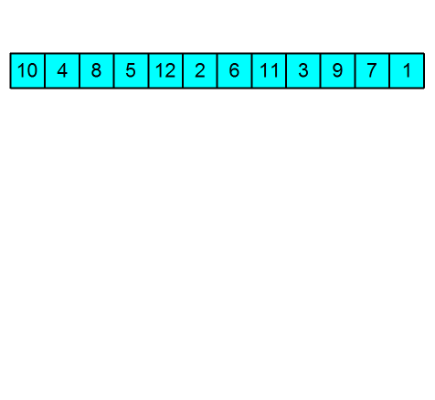
Advantages of Heap Sort:
Efficient Time Complexity: Heap Sort has a time complexity of O(n log n) in all cases. This makes it efficient for sorting large datasets. The log n factor comes from the height of the binary heap, performance even with a large number of elements.
Memory Usage – Memory usage can be minimal because apart from what is necessary to hold the initial list of items to be sorted, it needs no additional memory space to work
Simplicity – It is simpler to understand than other equally efficient sorting algorithms because it does not use advanced computer science concepts such as recursion.
Disadvantages of Heap Sort:
Costly: Heap sort is costly.
Unstable: Heap sort is unstable. It might rearrange the relative order.
Efficient: Heap Sort is not very efficient when working with highly complex data.

Slide 49
Code of Heap Sort

Slide 50

Thanks for attention!
Made by: TEAM-1
Racabov Ilkin
Heybatova Maleyka
Huseynli Tunay
Aghayev Ceyhun

